Slide 1
Hawks Clinic
Micah Arabie, BSN, RN

Slide 2
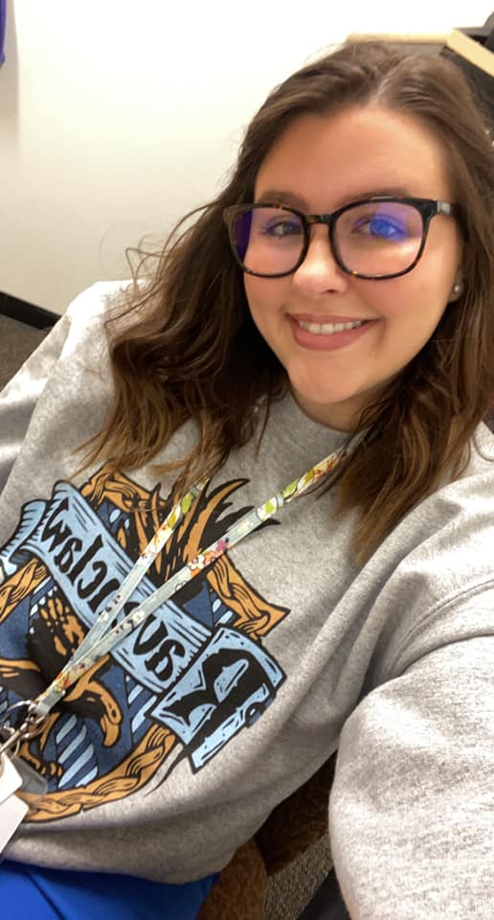
Your School Nurse
My name is Micah Arabie
This will be my 3rd year as a school nurse.
I am a graduate of UTHealth Cizik School of Nursing, earning my Bachelor of Science in Nursing.
I have an amazing husband and two beautiful CORGI children.
I am SO EXCITED to be a Hawk!

Slide 3
Clinic Overview: What do I do?
Handle on-campus injuries and acute illnesses
Management of students with chronic conditions (ex. Diabetes, asthma)
Administer scheduled/PRN medications for acute/chronic conditions (generally before school and at lunchtime)
Works collaboratively with teachers, counselors, administration and parents to ensure students’ health needs are met

Slide 4
Who can I send to the clinic?
Breathing difficulties (asthmatic requiring inhaler, shortness of breath)
Rash with severe itching and/or rapid spreading
Eye injuries or possible eye infection
Wounds that are bleeding and/or draining and are too large to be covered by a bandaid in class
Sudden, SEVERE pain of any nature
Visible injury/dismemberment (ex. Fractured bone)
Vomiting (must be witnessed and occur multiple times before it is considered a nurse-excused absence)
With current COVID guidelines (subject to change), student complaints of:
Sore throat
Muscle aches
Chills and/or visible shaking
Coughing
Cold/flu-like symptoms

Slide 5
What can I manage in class before sending to the nurse?
Band-aids for wound that is not bleeding or draining (ex. papercut)
Minor seasonal allergy symptoms (GCCISD does not allow us to provide medication for students)
To use the phone for nonmedical reasons (such as ordering lunch from Mom)
Chapped lips
Minor aches and pains (if persistent, call me)

Slide 6
COVID 19
The Highlands Nurse is responsible for STUDENTS with or suspected of COVID19. If you have questions regarding your own COVID 19 isolation/leave days, please contact our campus COVID coordinator.
Student COVID isolation/quarantine policy is currently a 5-day isolation for students who are confirmed COVID positive.

Slide 7
Field trips
If you have a field trip coming up, please notify me ASAP! Ideally, I will be notified at least one week prior to the field trip. There is a lot of prep that goes into field trips on my end, and we want to ensure students attend these field trips safely.
Training may be required if you have a student with a medical condition attending.
Please send me a roster ASAP to begin reviewing medical conditions. I will work with you to arrange a day/time to go over any noteworthy information.

Slide 8
Reminders
If your student is having an EMERGENCY during class, please call me at ext. 38010. If I do not answer, please call the front desk to have them contact me by radio.
Student should not be escorted to the Clinic by another student unless they have a safety plan requiring this. If you feel they are unsafe to walk alone, please call me to bring the wheelchair to escort them.
All students must have specific permission and a PASS (see next slide) to visit the Clinic.

Slide 10
Thank you!!!

